Slide 1

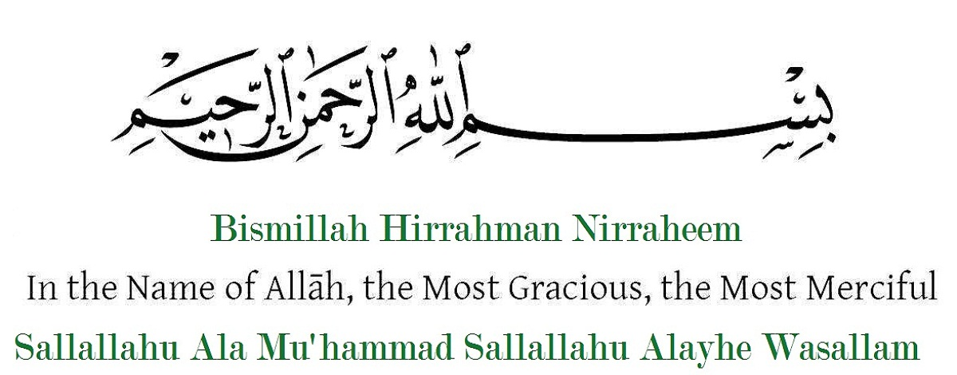

Slide 2
Web Hacking - Attacks & Defense
Mohd Haji @mohdhaji24

Slide 3
$whoami
→ 22 years old Bug bounty hunter working as Information security specialist @COEIA….
→ Facebook no.1 whitehat hacker from Hyderabad India (2015,2016 & 2017)
→ Bugcrowd top 100 security researcher in world.
→ 2 times Paypal top 10 bug hunter in world.
→ Secured more than 100 websites which includes Google, Microsoft,etc
→ Sports i like cricket & kabadi..

Slide 4
DISCLAIMER
This presentation is solely for educational purpose . Presenter is not responsible for any misuse of information by any individual.

Slide 5
Agenda
→ SQLI → XXE
→ Command Injection → Oauth 2.0
→ IDOR → LFI
→ XSS → Subdomain takeover
→ CSRF

Slide 6
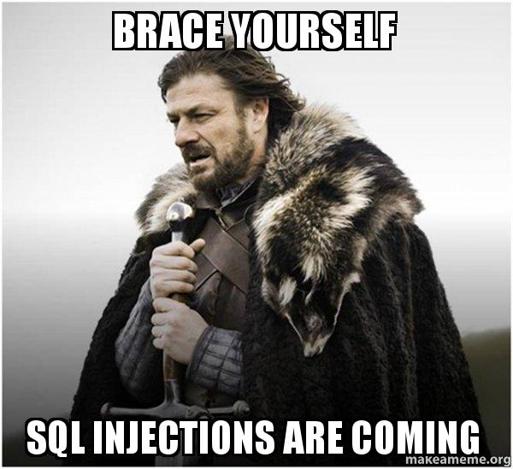
SQL injection
Attacks :
→ Inband SQLI and Outband SQLI .
→Insert single quote (‘) or double quote (“) to break the
structure of query sql=”Select * from table where id=’$id’”; ( if $id= ‘ or 1=1-- - )
→ Classic sqli(error based) , Blind Sqli (time based , boolean - true, false)

Slide 7
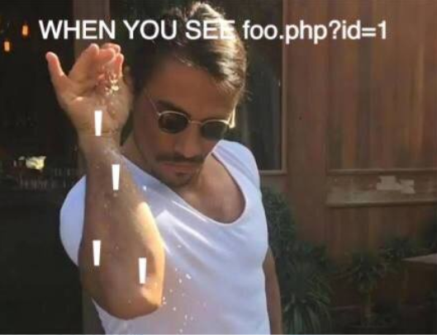
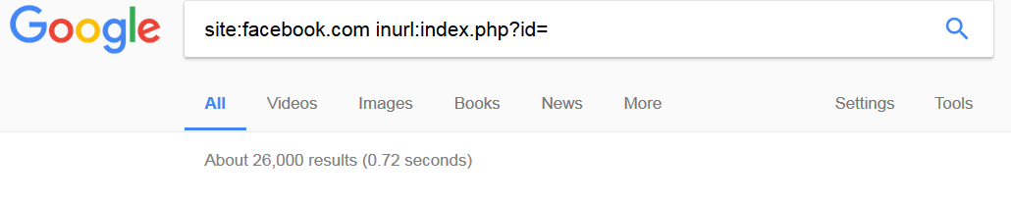
Google dorks
inurl:index.php?id=
inurl:news.aspx?id=

Slide 8
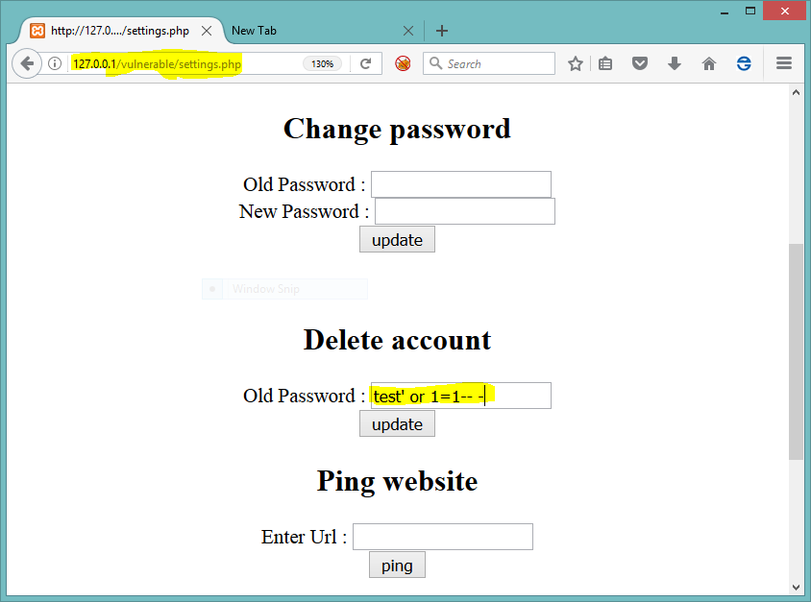
Classic sqli :
Payload :
Test’ or 1=1-- -

Slide 9
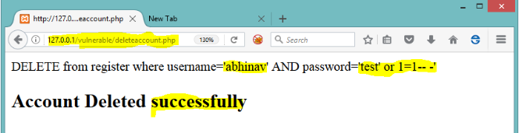
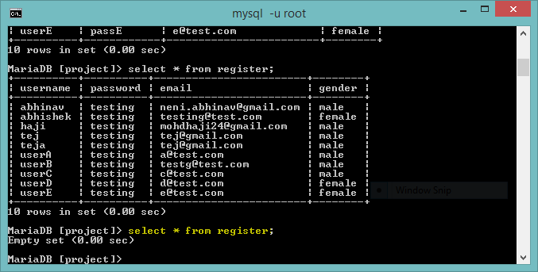

Slide 10
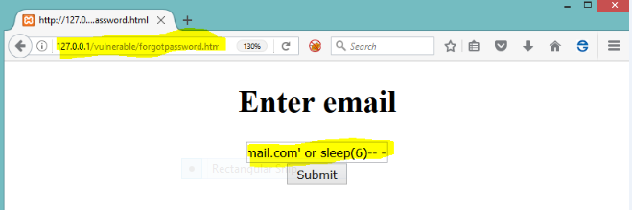
Blind sqli :
Time based payload
If vulnerable then its
Response time gets
increased.

Slide 11
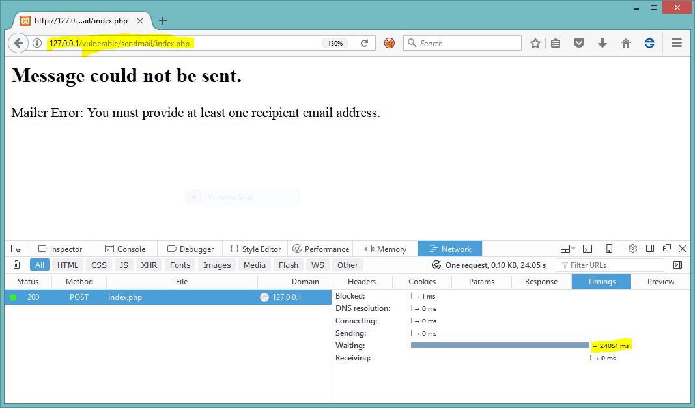

Slide 12
Defense :
→ Thumb rule (Never trust user input).
→ Use parameterized queries or prepared statements.
→ Use Regex (regular expressions) for validating user input.
→ Apply Test Driven Development approach ( attack your own code with list of payloads before using on prod server).
-->Don’t concatenate strings in Stored procedures.
→ Crawl for SQLI keywords in source code .

Slide 13
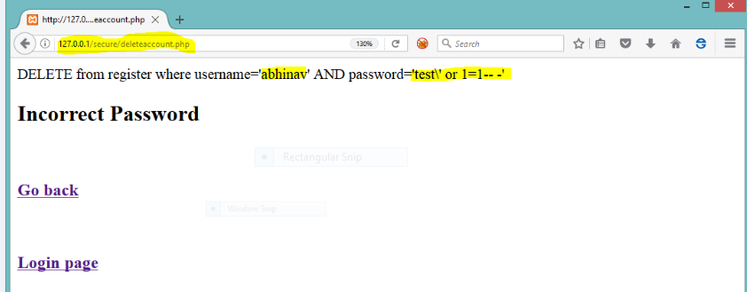
Adding parameterized
Query (Prepared statements)
Or in php
Mysqli_real_escape_string()
For string escape,etc

Slide 14
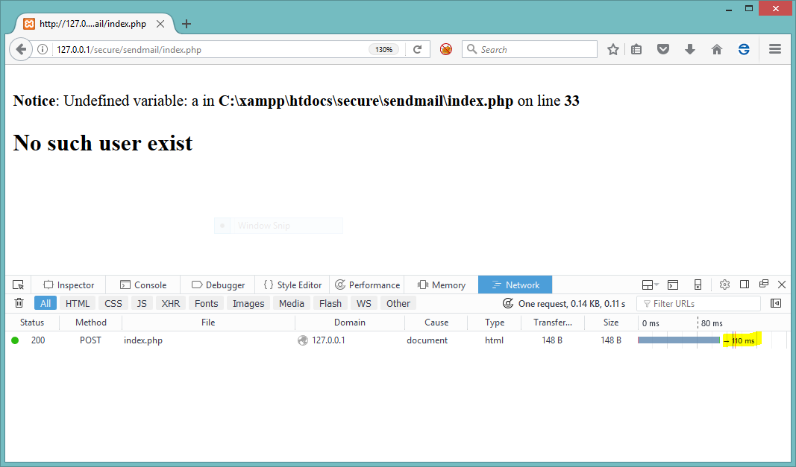

Slide 15
Command injection
Attacks:
→ user input is directly passed into system() or eval() , exec() ,etc
→ use delimiters to perform attack ; (semicolon) , | (pipe) , && ,etc
→ $host = $GET[‘$host’] ; $cmd=”ping”.$host; echo system( $cmd);
Eg.: host=google.com , cmd= ping google.com
Attack vector = google.com | dir

Slide 16
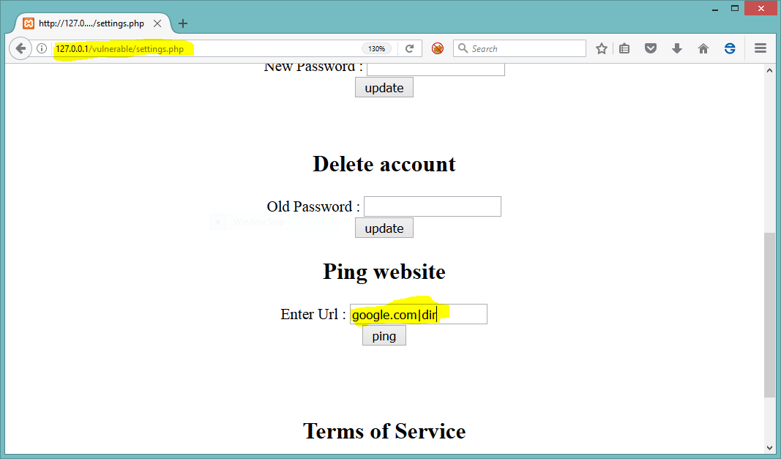
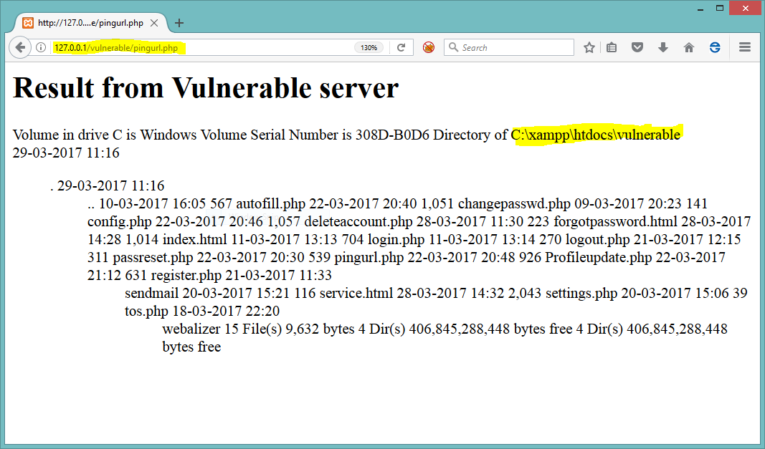

Slide 17
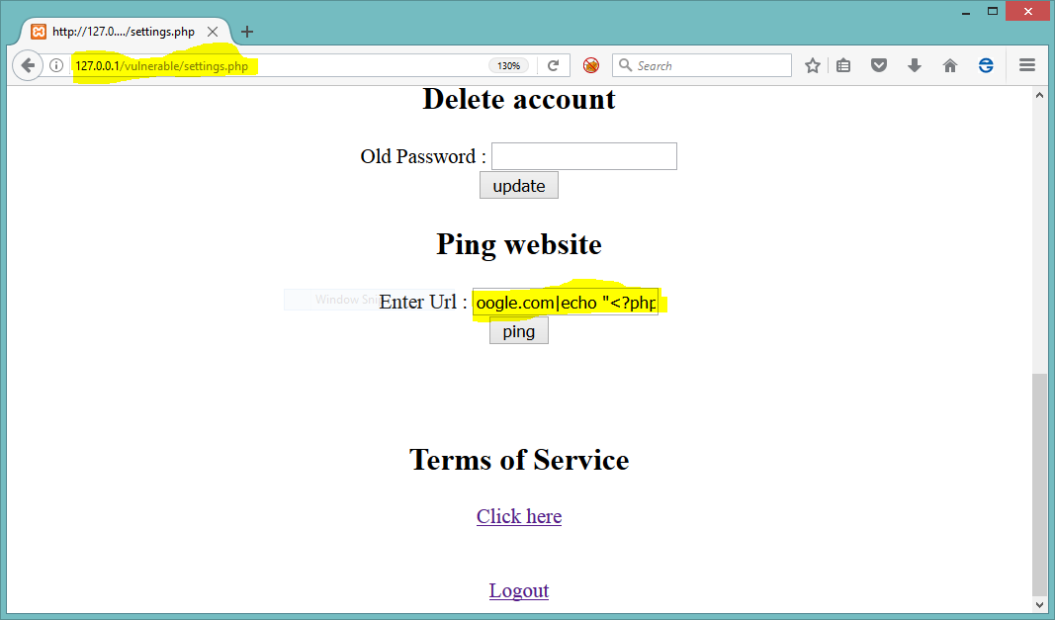
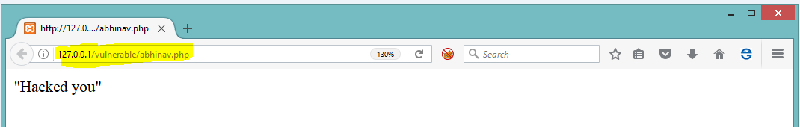

Slide 18
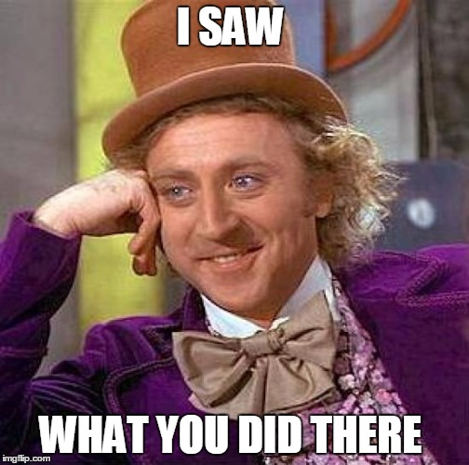

Slide 19
Defense
→ Sanitize user input ( filter command terminators ;, || , &&).
→ Try to avoid using dangerous functions system() , eval() ,etc
→ Use safe apis
escapeshellcmd() ,etc.
E.g : escapeshellcmd(system($cmd));

Slide 20
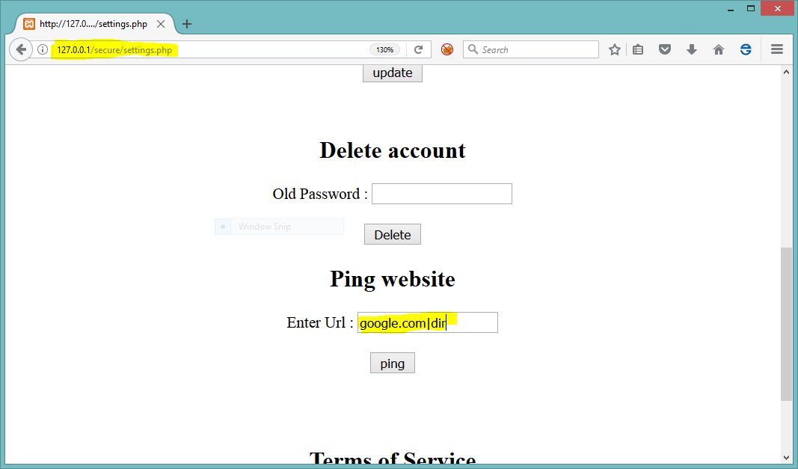
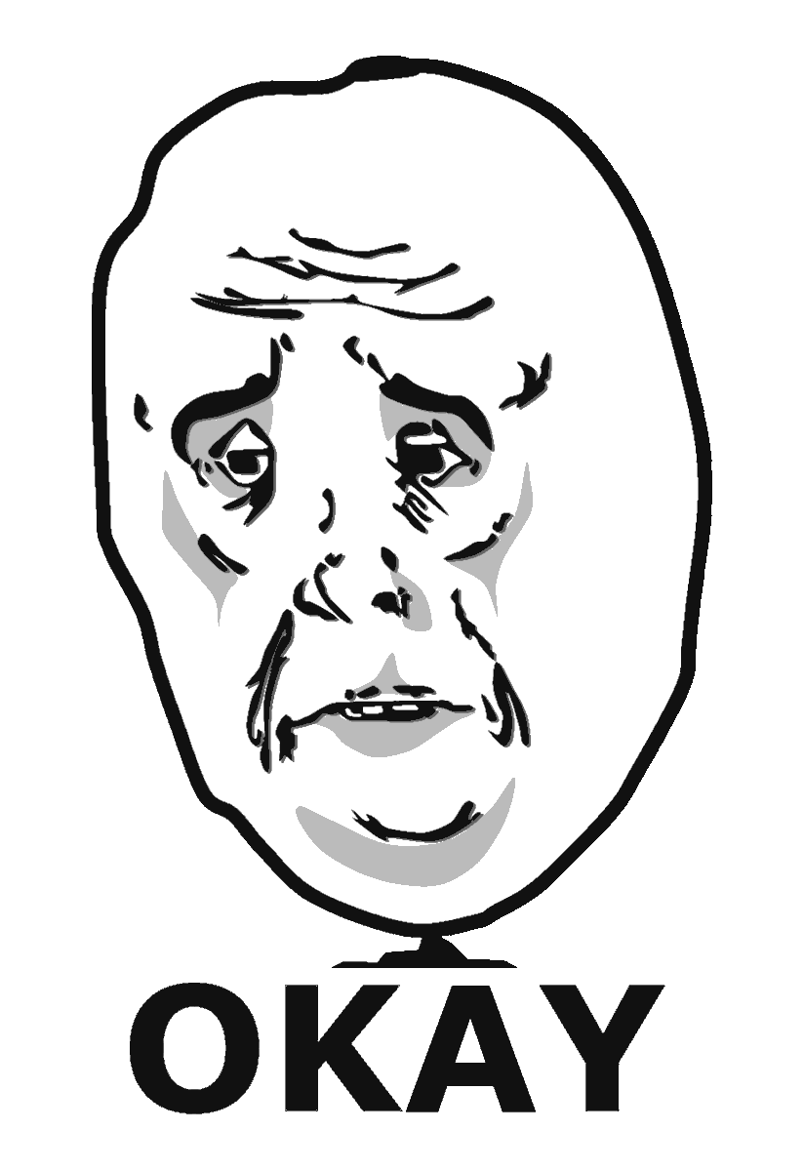
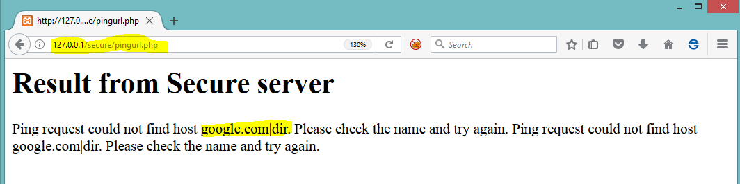

Slide 21
Insecure Direct Object Reference
Attacks:
→ Direct access to data objects based on user input.
→ Insecure application business logic.
→ Accessing or modifying or Changing other users information by modifying user id or any other identifier without user interaction.

Slide 22
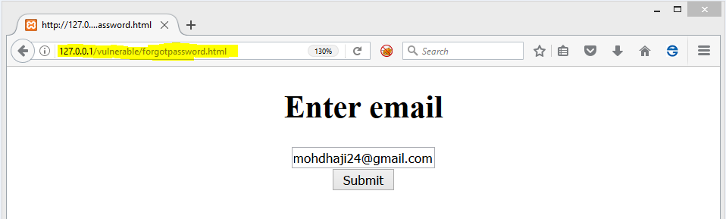
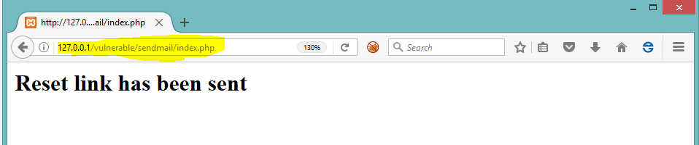
Password reset IDOR :

Slide 23
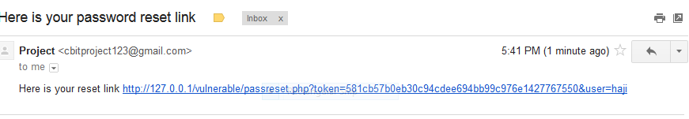
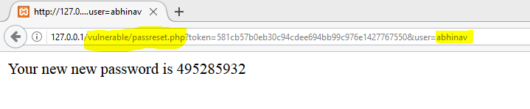
Change
username

Slide 24
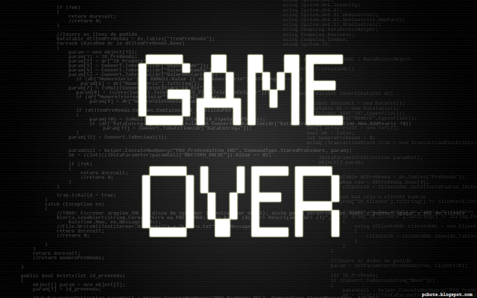

Slide 25
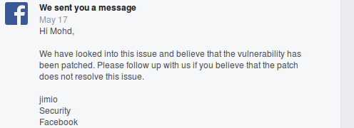
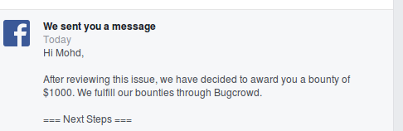
Whatsapp translate IDOR :

Slide 26
Defense:
→ Verify the primary id and foreign id properly by implementing access controls.
→ Check the user authorization to particular resource.
→ For sensitive actions use double authentication or OTP based approach.
→Use hashing for userid (like GUID).

Slide 27
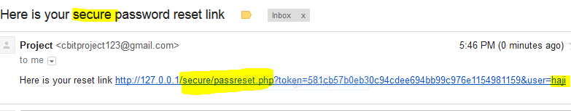
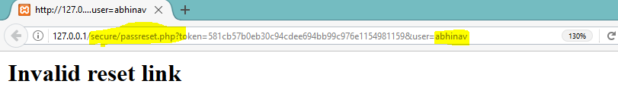
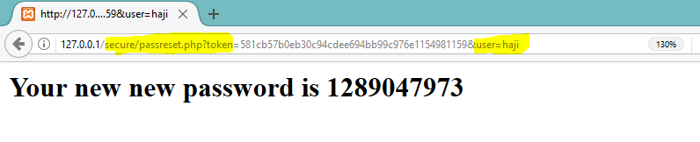
Change
Username

Slide 28
Cross site scripting (XSS)
Attacks:
→ User input reflected back to html page without output encoding or sanitization from server.
→ Malicious code is injected into applications (<script>alert(“Hacked”);</script>),
(Note: xss means attacker has control over browser , can read anything)
→ Persistent XSS (Stored Xss) - payload stored in database.
→ Non persistent XSS (Reflected Xss) - payload sent via link.

Slide 29
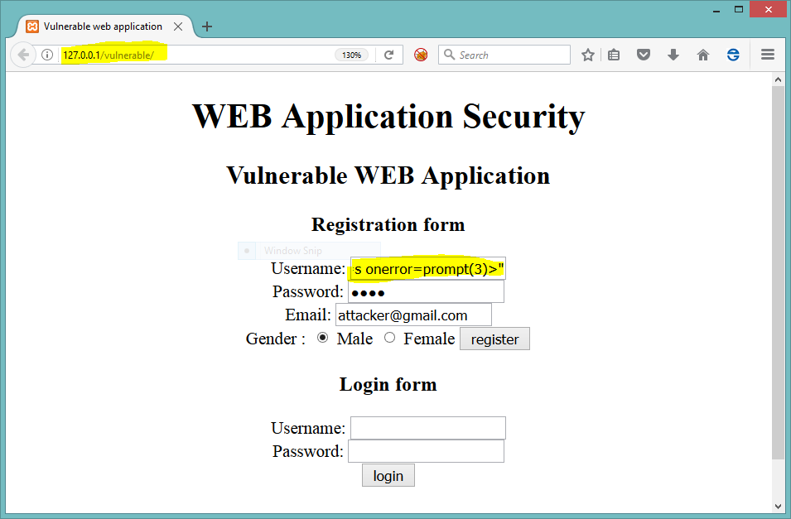
Payload=
“><img src=x
onerror=prompt(3)>”

Slide 30
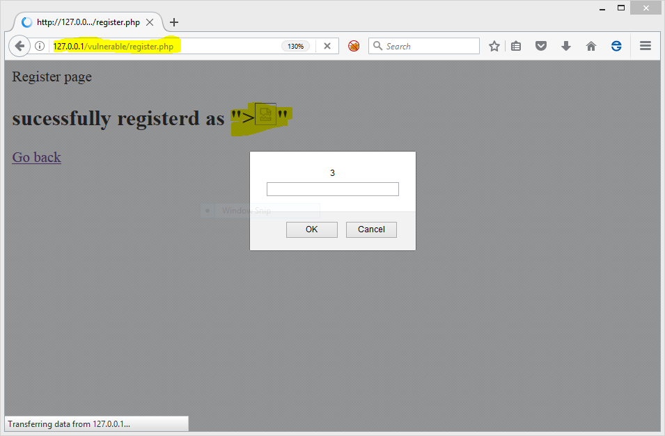
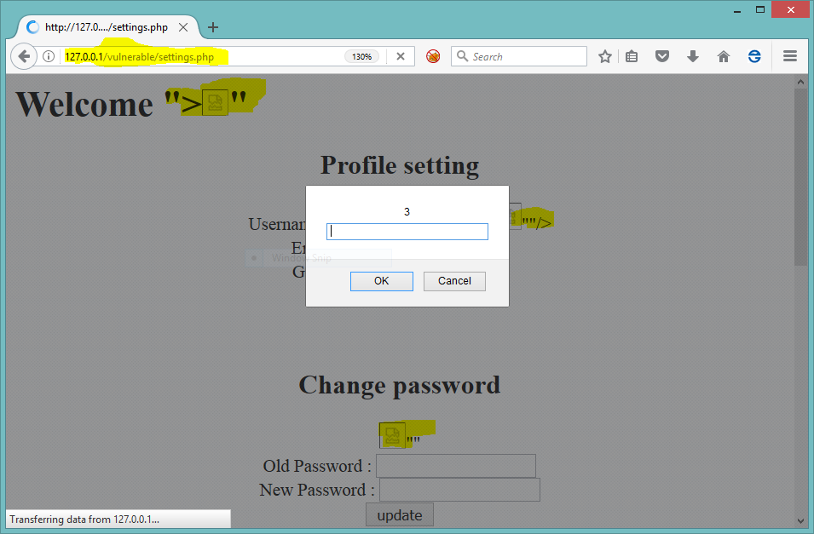
Reflected user input ---->
<---- Stored user input from database

Slide 31
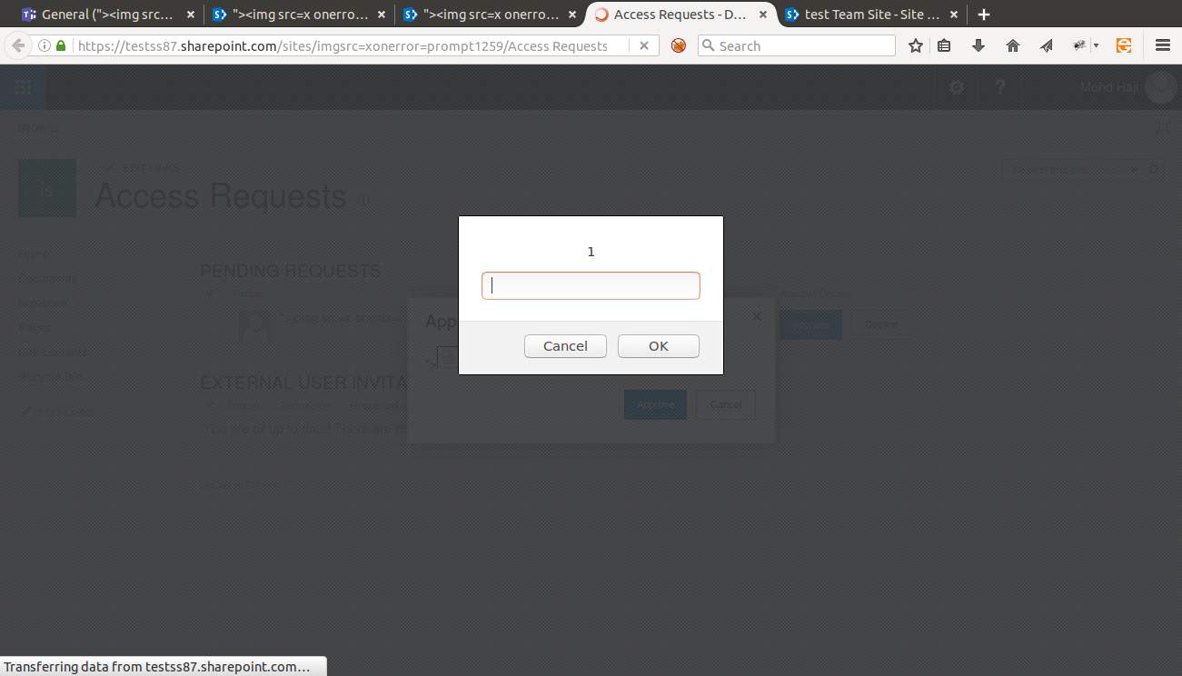
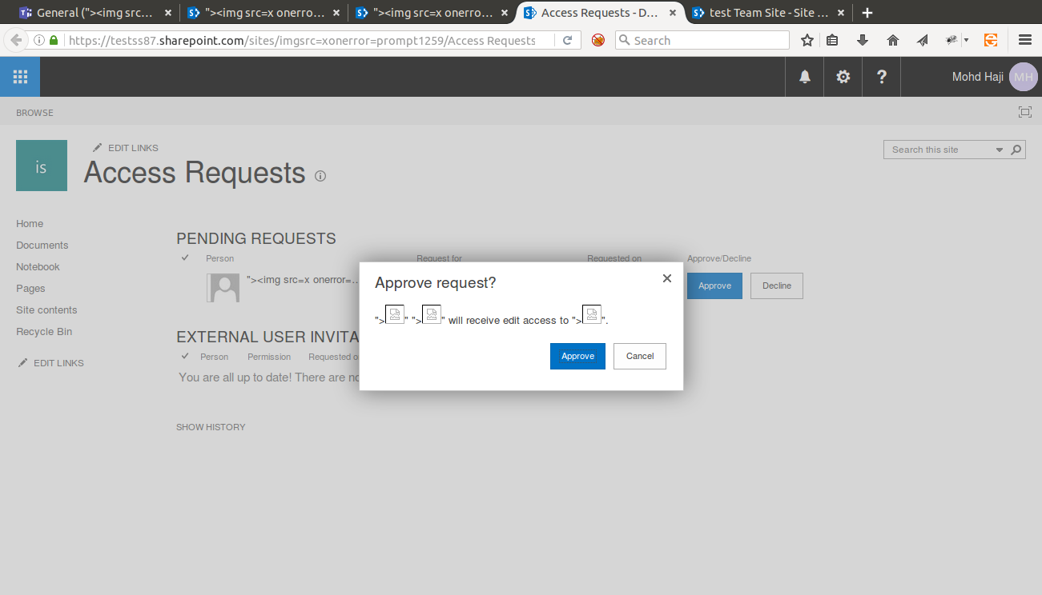
Microsoft Sharepoint stored XSS:

Slide 32
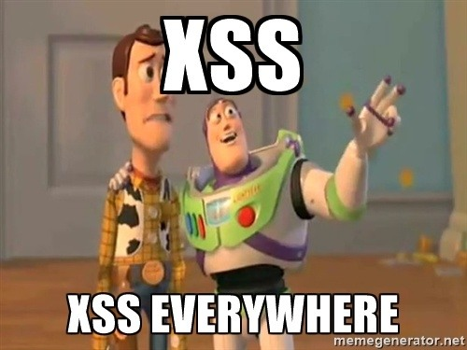

Slide 33
Defense:
→ Htmlencode output which is dependent on user input.
→ htmlencode($GET[‘username’]); in php.
“<” converted to &lt and “>” converted to &gt which are htmlentities.
→ Use Anti-xss library in .NET
→ Use RequestValidation in .NET ( It identifies malicious characters
In user input)

Slide 34
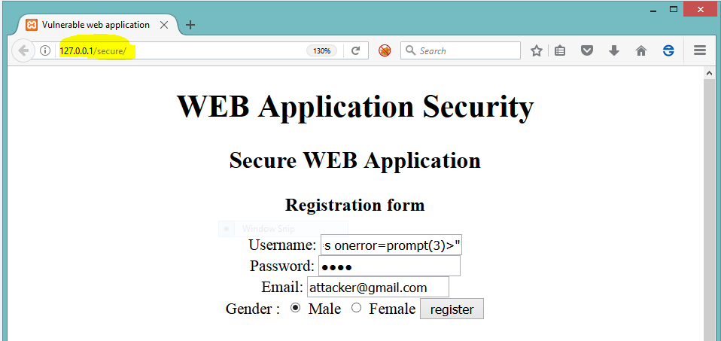
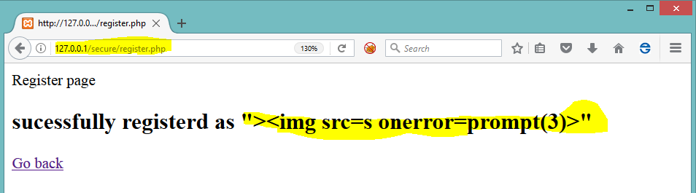
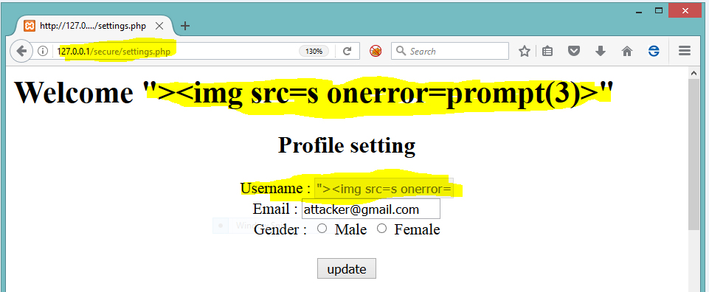
Htmlencoding to
username

Slide 35
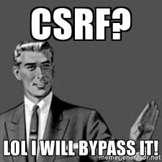
Cross site request forgery (CSRF)
Attacks:
→ Attacker Forces the victim to perform unwanted state changing actions.
→ Checking for csrf
->Token is present or not .
-> If present is it validated at server side?
-> Removing token works?
-> Is it checking based on length?

Slide 36
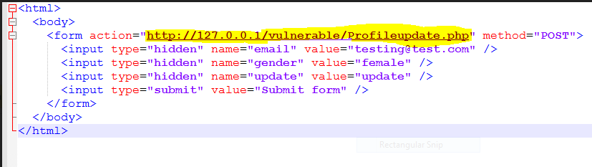
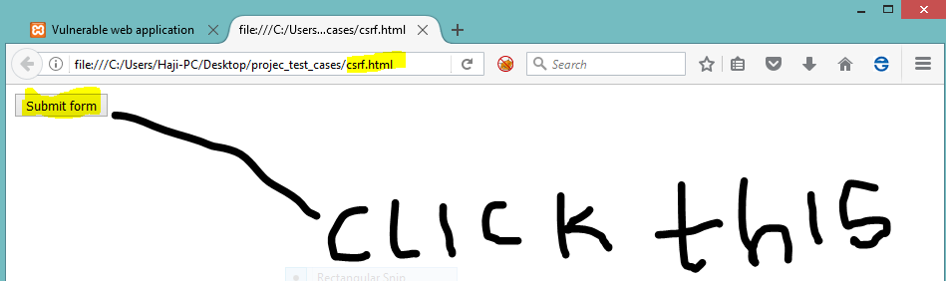
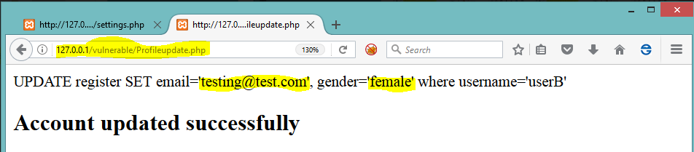

Slide 37
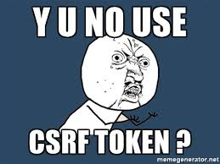

Slide 38
Defense:
→ Use anti-csrf cryptographically strong random tokens in hidden field or custom header.
→ Verify referer header and origin header . ( XSS can bypass this , so be carefull).
→ Add captchas and password confirmation to sensitive areas to prevent csrf.
Such as password reset , email change , delete account, etc.
→ Common misunderstanding (using POST instead of GET eliminates CSRF )
→ Viewstate by default cannot prevent CSRF in .NET , you need to enable viewstateuserkey which append random csrf token to viewstate.

Slide 39
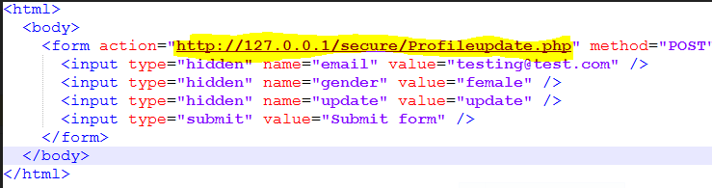
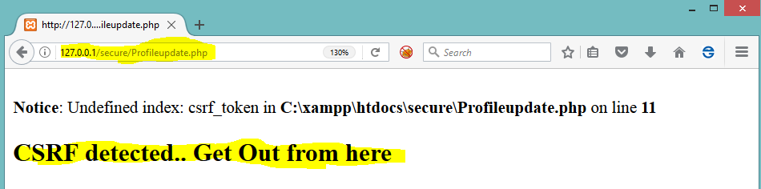
Token validation

Slide 40
XML - External Entity (XXE)
Attack:
→ Xml input data is parsed by weakly configured parser which parses external entities defined in custom DTD.
→ Its very rare to find XXE.
→ Sometimes changing content type from json to xml also works where we can try for XXE.

Slide 41
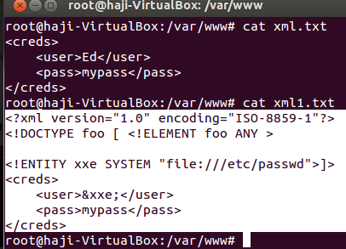
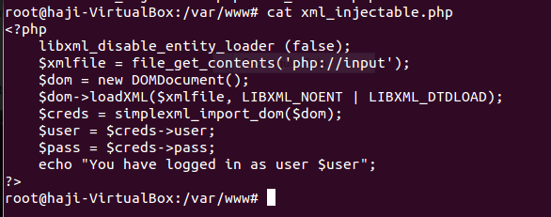
Weakly configured parser :
disable_entity_loader(false)

Slide 42
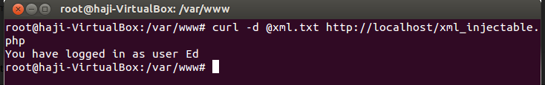
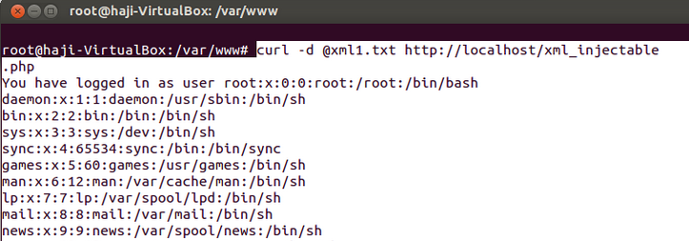
Internal
File(/etc/passwd)
Data disclosed

Slide 43
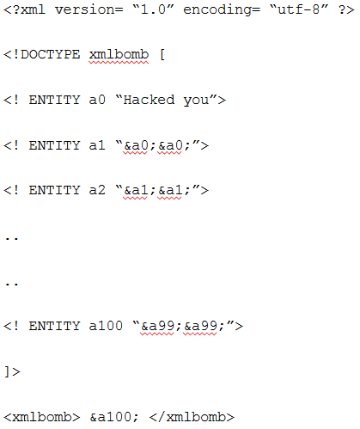
XXE Bombs:
→ when Execution a100 refer a99
Which refer to a98,etc,etc
And we end up with huge string
Of “Hacked you”, leading DOS.

Slide 44
Defense:
→ Just disable Document type definition DTD while parsing xml input.
→ For PHP
libxml_disable_entity_loader(true);
→ For .NET
XmlTextReader reader = new XmlTextReader(stream); reader.ProhibitDtd = true;

Slide 45


/etc/passwd
not disclosed

Slide 46

OAuth 2.0
→https://www.facebook.com/v2.0/dialog/oauth?client_id=123&redirect_uri=https%3A%2F%2Fwww.example.com%2Foauth%2Fcallback&response_type=code&scope=email&state=XYZ
client_id = App registered
redirect_uri = redirecting user after authorization
response_type= either code or token
scope= list of permissions given to client
state= random token

Slide 47
Attacks:
→ Bypass redirect uri by changing url or modify the url.
E.g: example.com is legal for client id=123 ,change example.com.sa (postappend)
Or find open redirect in example.com ,etc to steal the token .
→ Try to change response_type= code to response_type=token.
→ Try to add more scopes like scope=email to scope={email,name,number},etc
→ Check state parameter , if present try to remove it.

Slide 48
Defense:
→ Strictly validate redirect_uri with whitelisting approach instead of blacklist
→ As a best practise use response_type=code due to which client has to do call backs each time it calls resource server .
→ Strictly validate scope list with respective access controls.
→ Always add cryptographically strong random number as state parameter.

Slide 49
Local File Inclusion (LFI)
Attacks:
→ Including dynamic files based on user input .
→ Vulnerable code <?php include($_GET['filename'].“.php”); ?>
→ Using nullbyte %00 string ends .
E.g: filename=test . then include(test.php) ;
If ../../etc/passwd%00 then it becomes include(../../etc/passwd) ;
→ If characters are blacklisted use encodings to bypass it (base64, hex,etc)

Slide 50



Slide 51


Use %00 nullbyte
Then it will include
../../passwords.txt

Slide 52
Defense:
→ Don’t include files based on the user input.
→ If not then maintain whitelist of all legal files which are allowed to be included and then using the identifier include the file.
→ Avoid appending just .html or .php thinking file gets appended , always
there is possible bypass such as null byte %00

Slide 53
Sub domain Takeover
→ DNS misconfiguration
→ Check CNAME of subdomain
E.g: help.example.com pointing to example.zendesk.com but it’s not
registered with zendesk.
→ Signup at zendesk , heroku, aws ,etc with the cname (alias) username .

Slide 54


Attack Scenarios:
→ Adding a phishing page, redirecting
users to malicious pages.
→ Xss payloads leading stored xss.
→ Steal sensitive information cookies,
etc.(even with secure flags)
→ Deface the website and completely destroying the business.
(Similar case happened to POTUS website ) .

Slide 55


Slide 56
Defense:
→ Always monitor your web services .
→ Remove the DNS pointing to external service
for not used websites/services.
→ Use tools such as sublistr3, pentest-tools, subbrute,etc
→ Few cloud providers (external parties) started mitigation from their end.

Slide 57
References:
->OWASP website & it’s code review guide
https://www.owasp.org/images/f/fa/Code_Review_Guide_Pre-AlphaV2_(1).pdf
→ Web hacking 101 - by peter yaworski
→Fransrosen from Detectify https://labs.detectify.com/2014/10/21/hostile-subdomain-takeover-using-herokugithubdesk-more/
→ Facebook OAuth 2.0 ( Philippe harewood)

Slide 58
Acknowledgement : (Special Thanks)
→ To my mentor Abhijeth Dugginapeddi (Application security consultant at Commonwealth Bank of Australia & Adjunct Professor @UNSW) for getting me into bug bounty & Security world .
→ To Alex Hollanda Silva ( Senior Director , Security operations at Salesforce , Washington USA) for changing my perspective towards application security & help in my learning process.

Slide 59

Thank You

